Slide 1
Particle Swarm Optimization (PSO)
Chapter 5

Slide 2
5.1 Introduction
In 1995, by Eberhart and Kennedy
Adapted to continuous optimization, when S ⊆ R^{N}
(≠ combinatorial optimization)

Slide 3
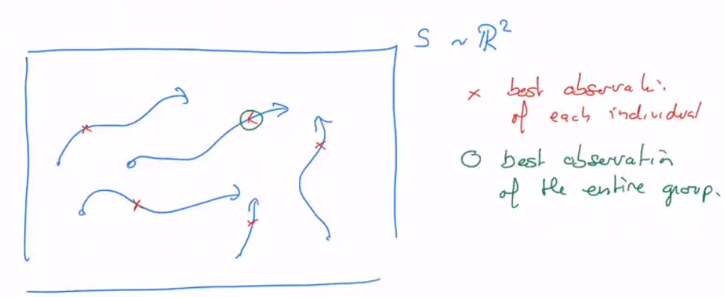
A swarm of particles that explore S in view of finding the global optimum.
It’s basically like a collective effect of birds, fishes or insects that together solve a difficult problem.
For PSO, the specificity is that the particles follows the best individual in the group, but also adjust their movement according to the best solution they have found so far.
the particles will tend to move either to their own best observation, or that of the best individual.
animals follow the leader (the one who knows best), but also follow their instinct.

Slide 4
5.2 PSO algorithm

Slide 5
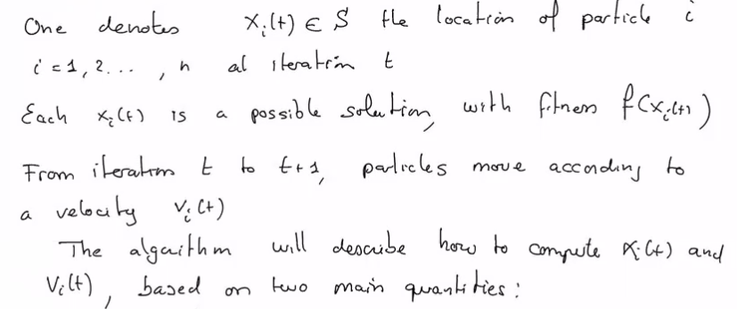
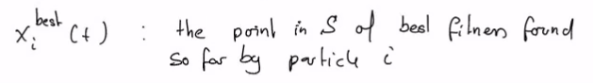
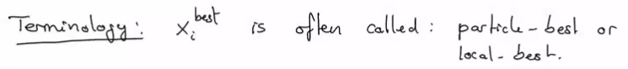
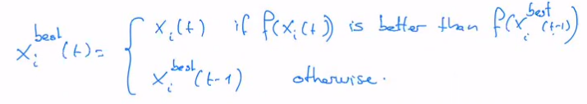

Slide 6
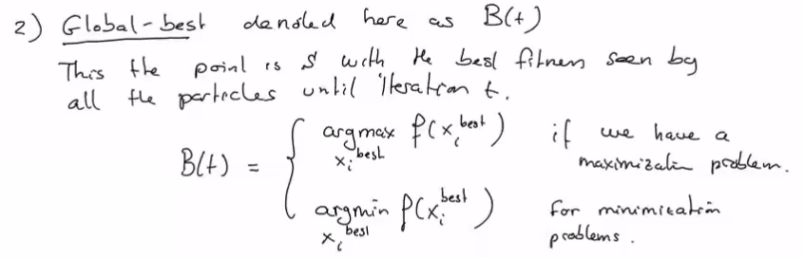

Slide 7
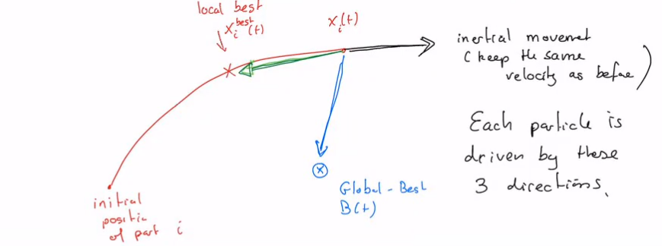
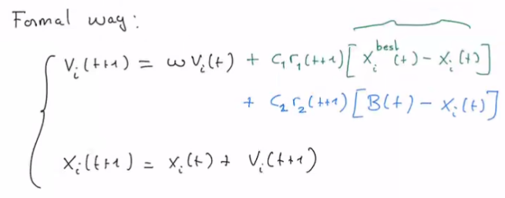
Movement of the particles

Slide 8
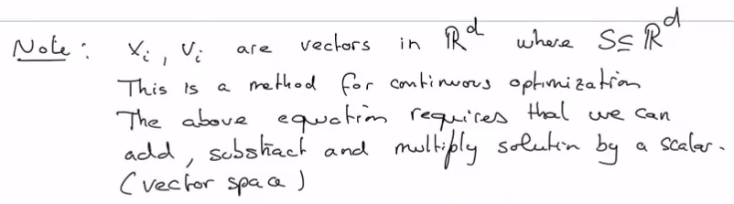
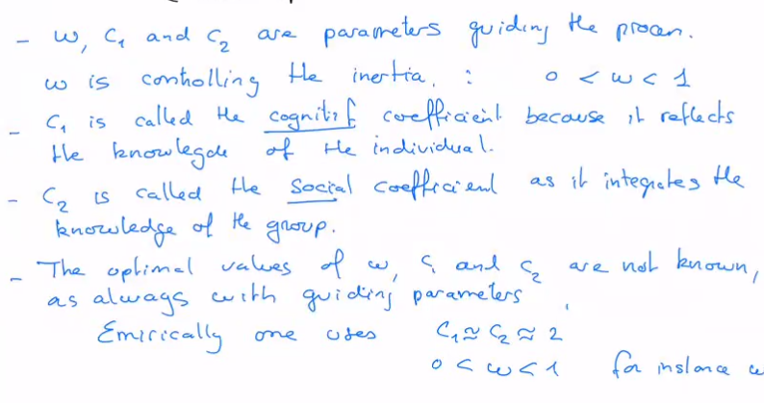

Slide 9
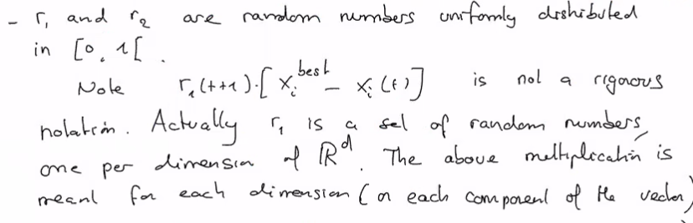

Slide 10
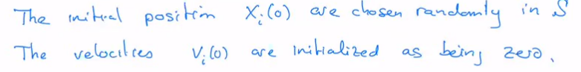
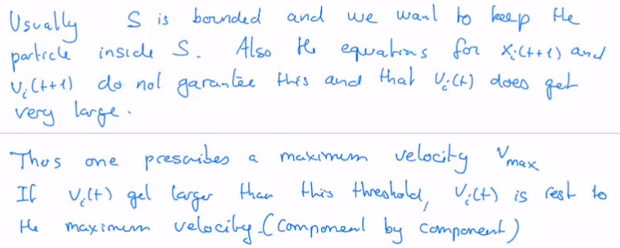
Initial conditions & Additional constraints

Slide 11
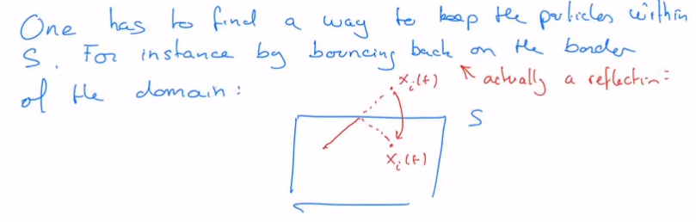
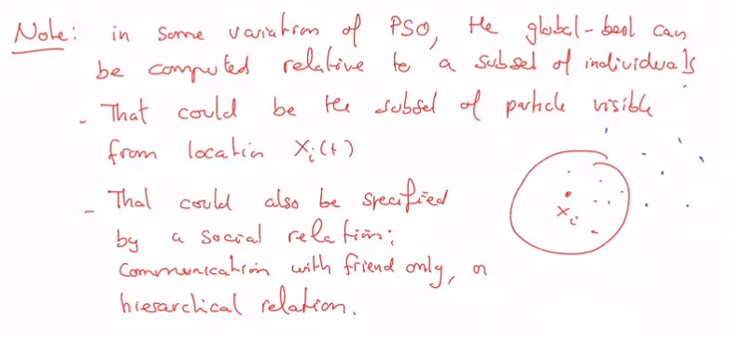

Slide 12
5.3 PSO Examples

Slide 13
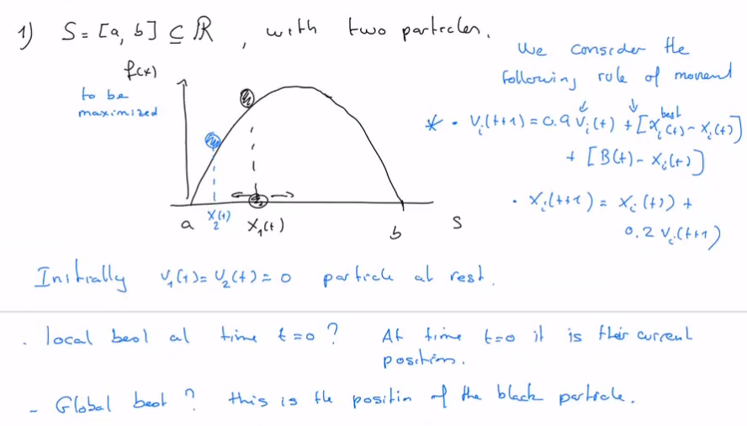


Slide 14
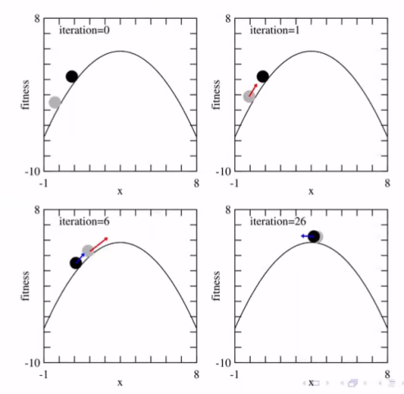
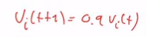
The black particle will not move until it’s no more the Global Best.
Then (iteration 6), both particles will go up by inertia, slowing down because of
When passing the maximum and goiong down the hill, they will be attracted toward their local and global best.
This goes to a convergence, after a few iterations both particles reach the top of the fitness landscape.

Slide 15
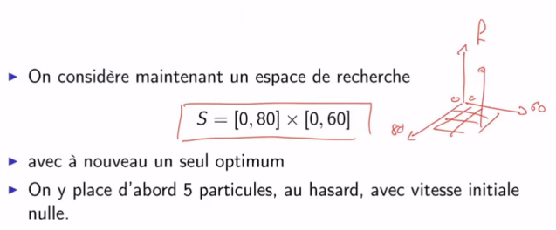
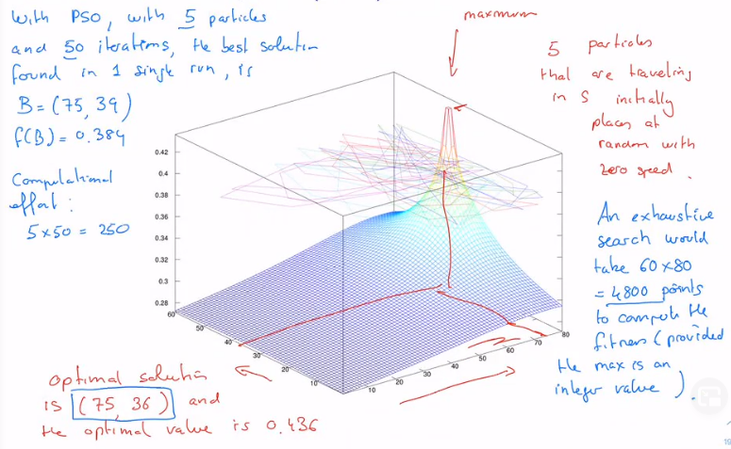
Example 2

Slide 16
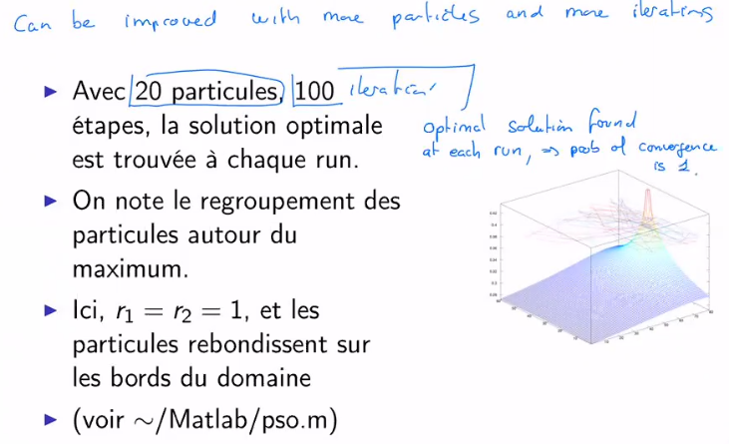
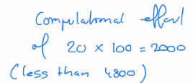
Example 2 (follow)

Slide 17
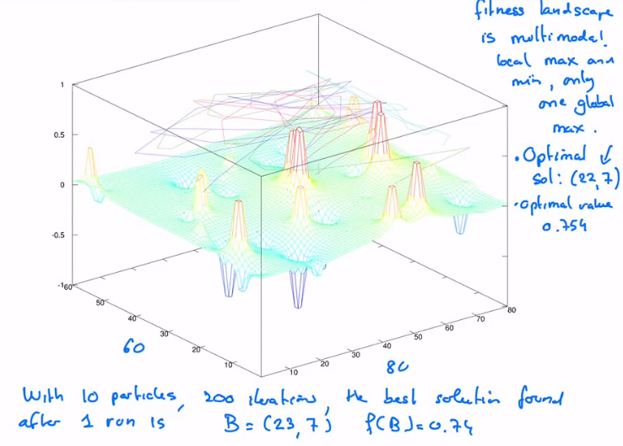
Example 3

Slide 18
Remarks
To apply PSO, we need to be able to compel a velocity.
For Boolean space, this is a bit less clear, but a Boolean space can be extended to real numbers and then rounded after.
For combinatorial optimization, this is less obvious: how to “add” two permutations, move towards one or the other, etc.
Some generalization to combinatorial optimization have been proposed.
PSO is a population metaheuristics:
It generates n solution at each iteration.
These solutions are used to generate the next ones, at iteration t+1
Performance of PSO:
Is usually good and it’s a recommended method for continuous optimization in multimodal search spaces
It competes well with genetic algorithms (chapter 6).

Slide 19
5.4 Firefly algorithm
In French “Lucioles”
2010, by Xin-She Yang for continuous optimization
But variations exists for discrete space

Slide 20
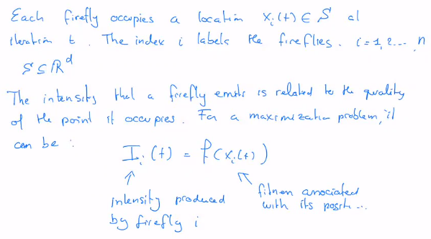
The algorithm
This method is inspired by PSO but now it considers the behaviour of fireflies which are able to find mate or attract preys by emitting light.
The idea is to play with the intensity of the light to mark promising locations in the search space.

Slide 21
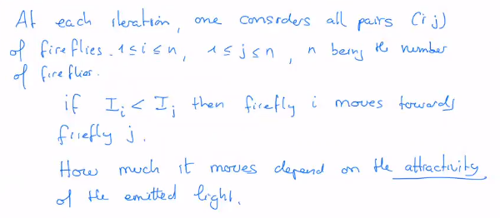
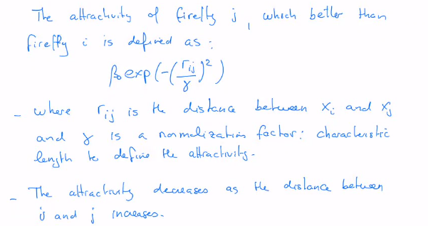
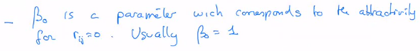

Slide 22
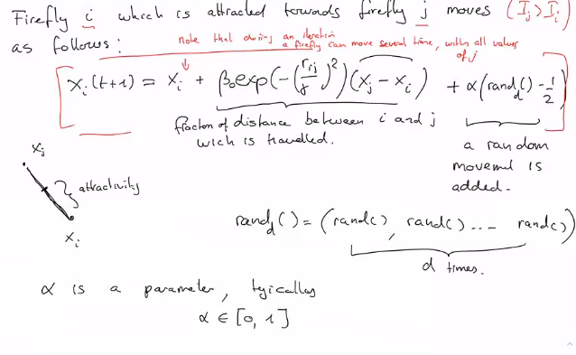

Slide 23
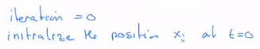
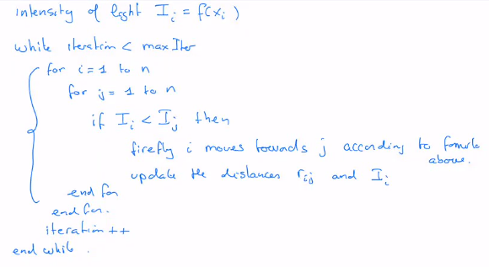
Firefly pseudo-code

Slide 24
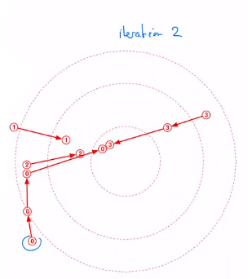
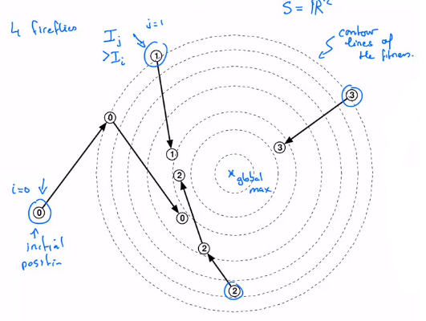
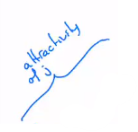
Firefly Example
At iteration 2 (on the right, zoomed):
Firefly 0 moves towards 1 that is better, then towards 2 and towards 3.
Firefly 1 moves towards 0 that has become better, but not towards 2 and 3 (worst)
Firefly 2 makes the same as 1
Firefly 3 moves towards 0 then 1, and is there better than 2 then don’t move.

Slide 25
5.5 Random displacement & Cuckoo Search
In 2010, by Yang and Ded
Used the behavior of the cuckoo bird as an inspiration for a new metaheuristics.
It’s adapted to continuous optimization S ⊆ R^{d} as Firefly and PSO.
A current solution can be modified randomly in the hope to get a better one. Often such random transformations are based on Gaussian numbers.

Slide 26
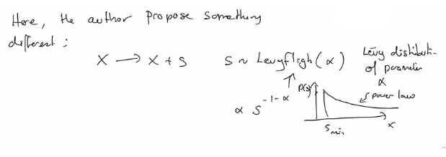
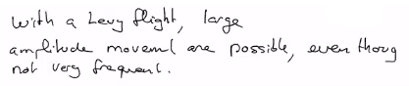
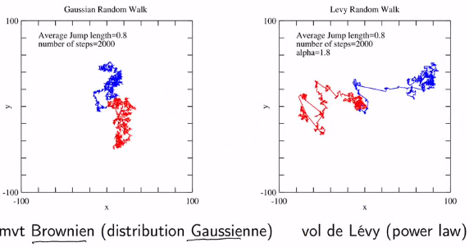
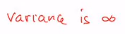

Slide 27
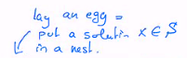
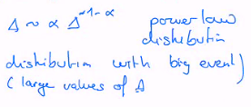
Cuckoo birds lag their egg in another species nest.
There are n nest available, as an array:
All the nests (or components) are filled with a random value x ∈ S.
At each iteration a nest is chosen randomly to receive a random quantity Δ from a Levy distribution:
X + Δ
This modified solution X + Δ is compared with the solution X_{j} in nest j:
If f(X_{i} + Δ) > f(X_{j}), X_{j} is replaced by X_{i} + Δ
Ιφ νοτ, X_{i} + Δ is abandoned
Another specificity of the Cuckoo search is that at each iteration a fraction p of the nests are renewed with random solutions.
This fraction p is that of the nest with the worst solution.
The analogy with the cuckoo bird is that sometimes the host bird discover that the egg is not its egg and gets rid of it.
 |  |  | X
1 | … | … | i | … | … | … | n

Slide 28
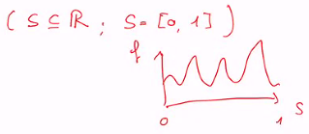
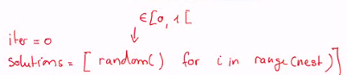
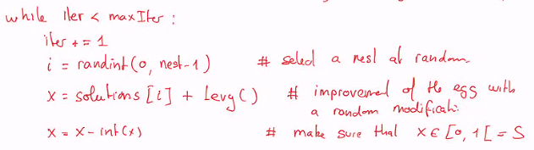
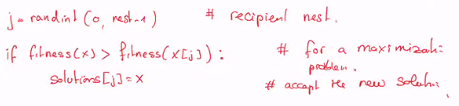
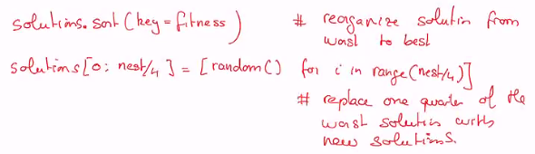
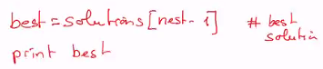
Algorithm

Slide 29
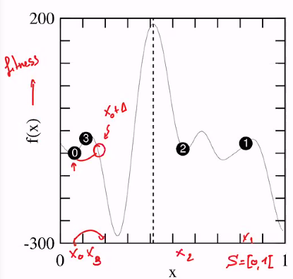
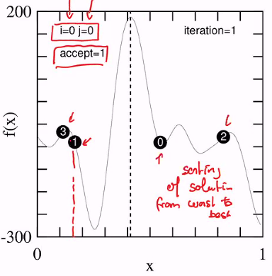
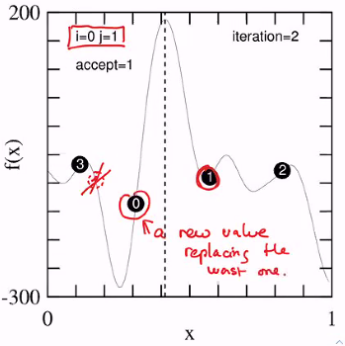
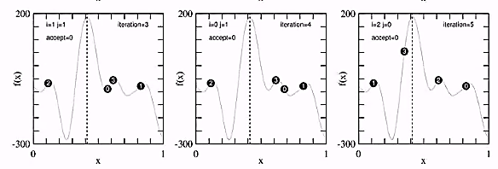
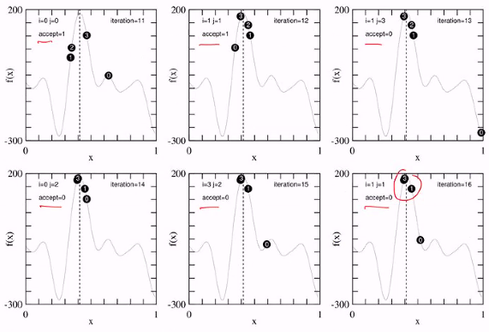
We see a convergence towards the maximum of the fitness, but the number of accept is small.

Slide 30

As we only remove bad solutions, we can never go down.
Cuckoo search find after 16 iterations the solution x = 0.399, f(x) = 180.66.
The optimal solution is however x* = 0.4133, f(x*) = 187.785.
Cuckoo search is 5% off the optimal solution
With 3 nests repopulated randomly at each iteration, one get x = 0.4137, f(x) = 187.780 ≅ x*
Note: in the cuckoo search, with 4 nests and 16 iterations, only 4 egg replacements where accepted.
The improvements came from the replacement of nest 0 with the worst current solution by a random value.
At the same accuracy the random search (blue line) find the solution after 5 iterations only.
With 4 particles, that is a computational effort of 20 = 5 x 4, instead of 64 = 16 x 4.
Seems the cuckoo search is not more efficient that a random search.

